Slide 1
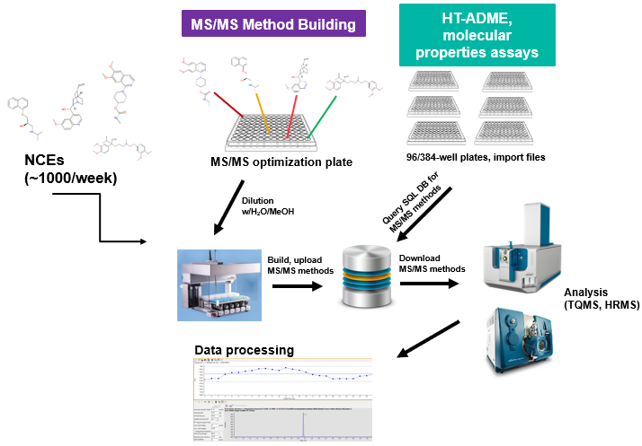
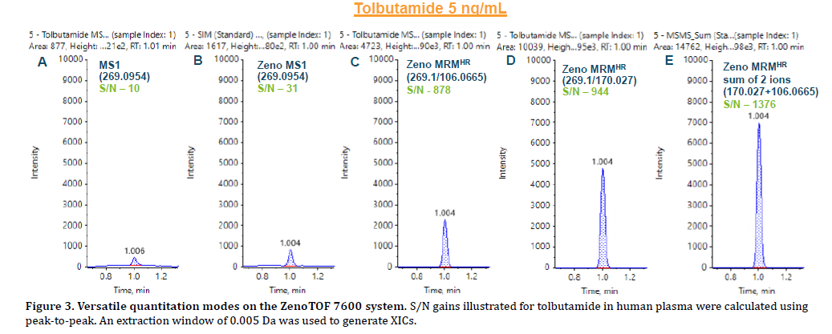
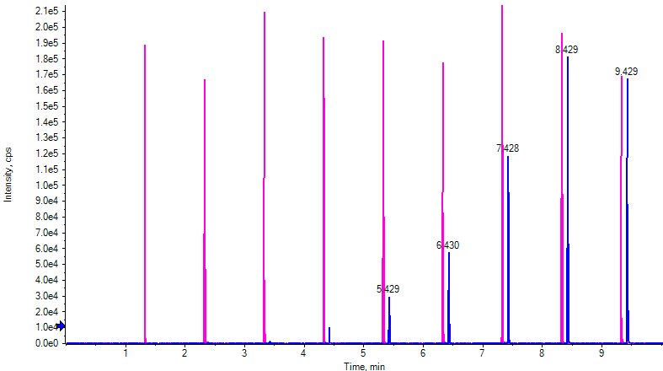
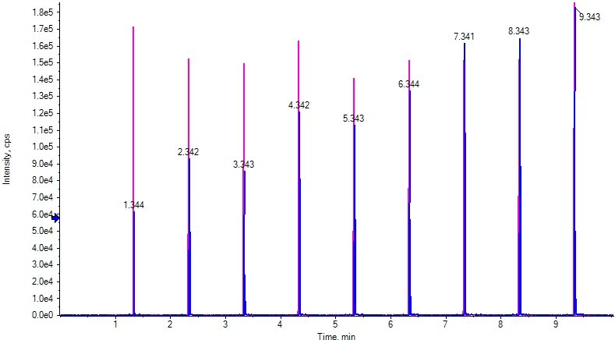
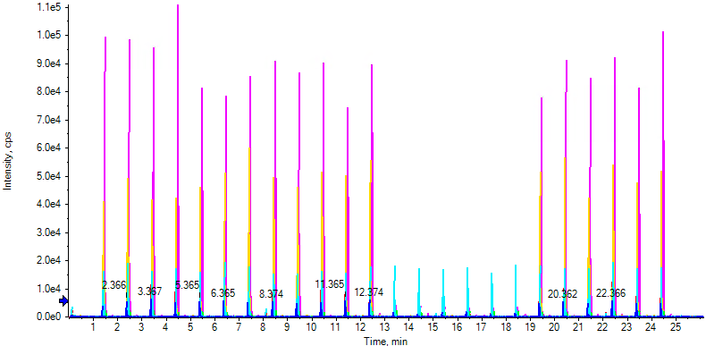
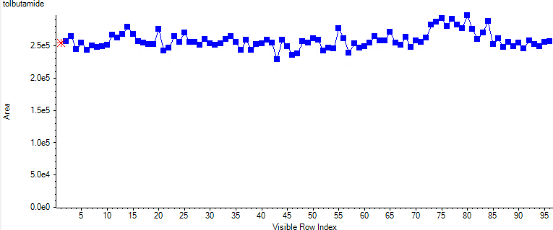
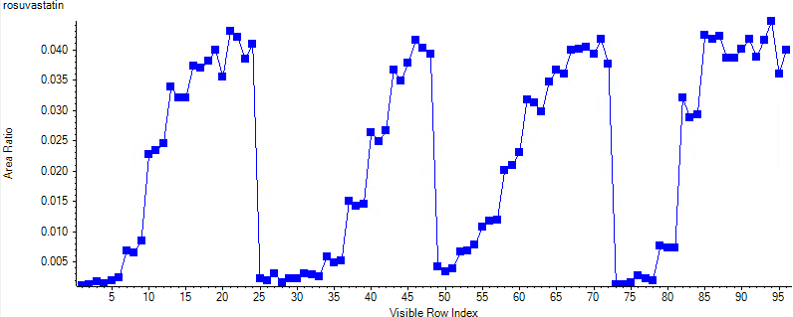
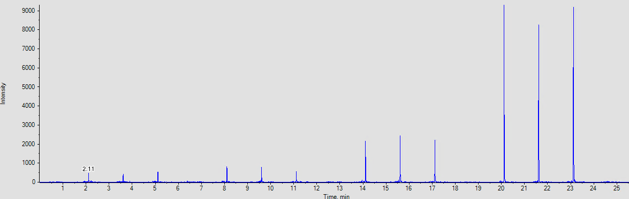
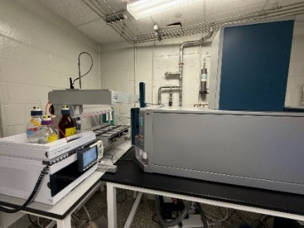
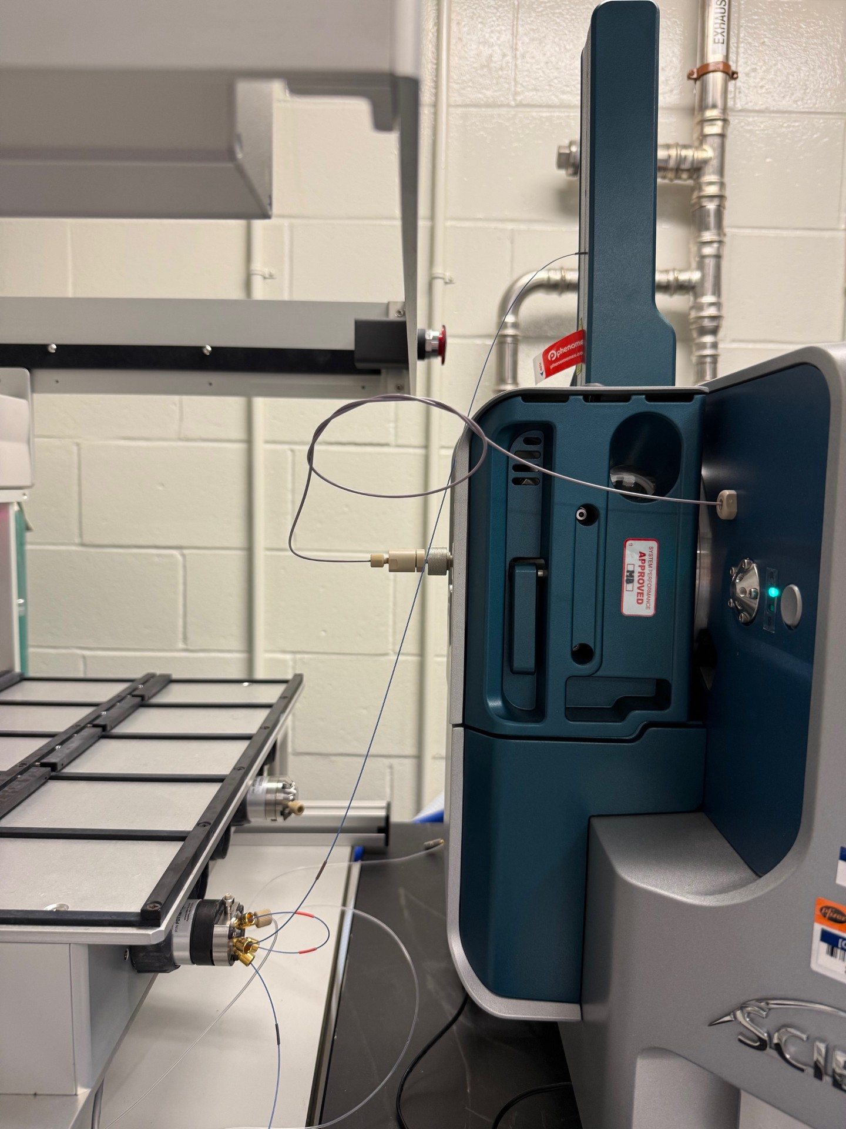
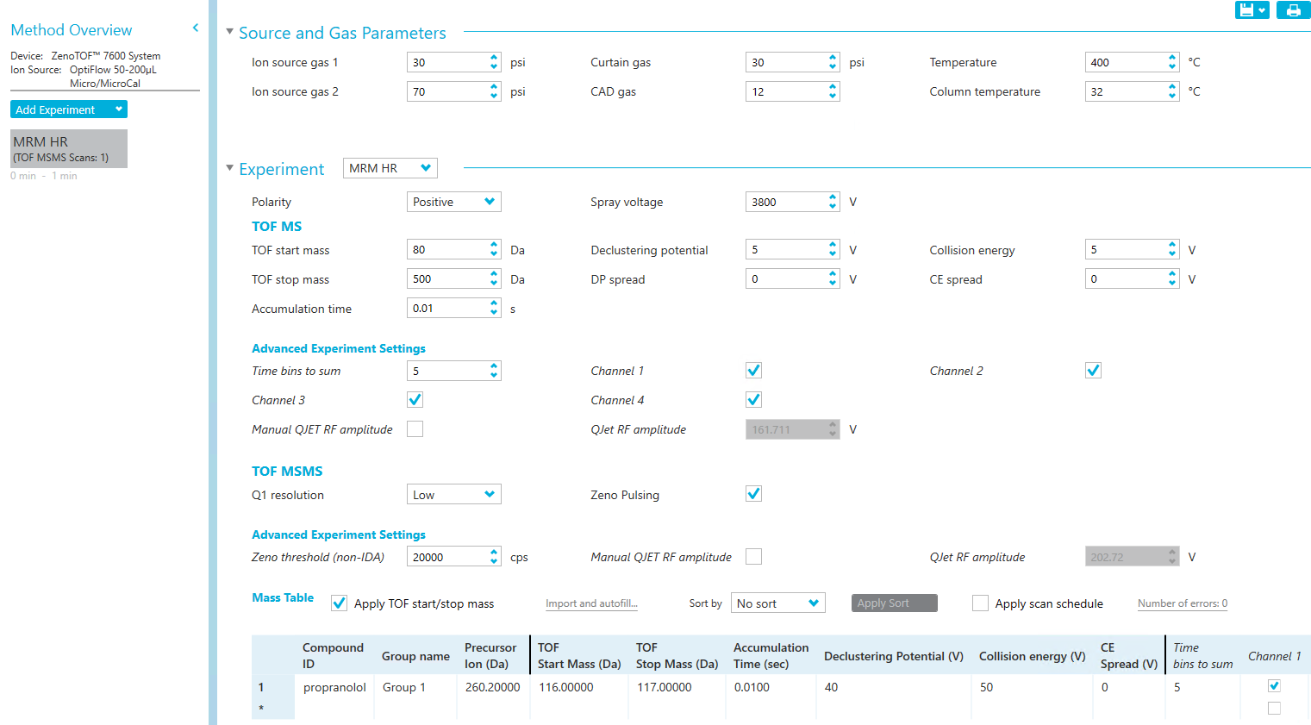
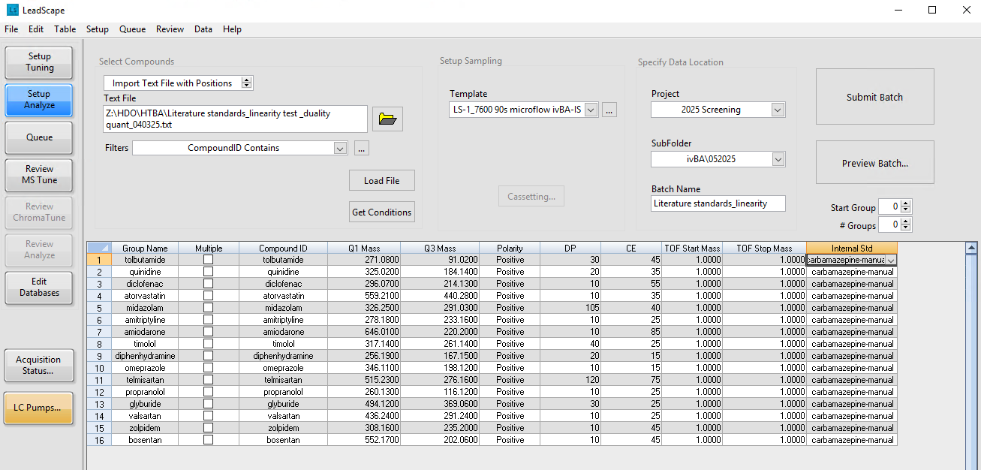
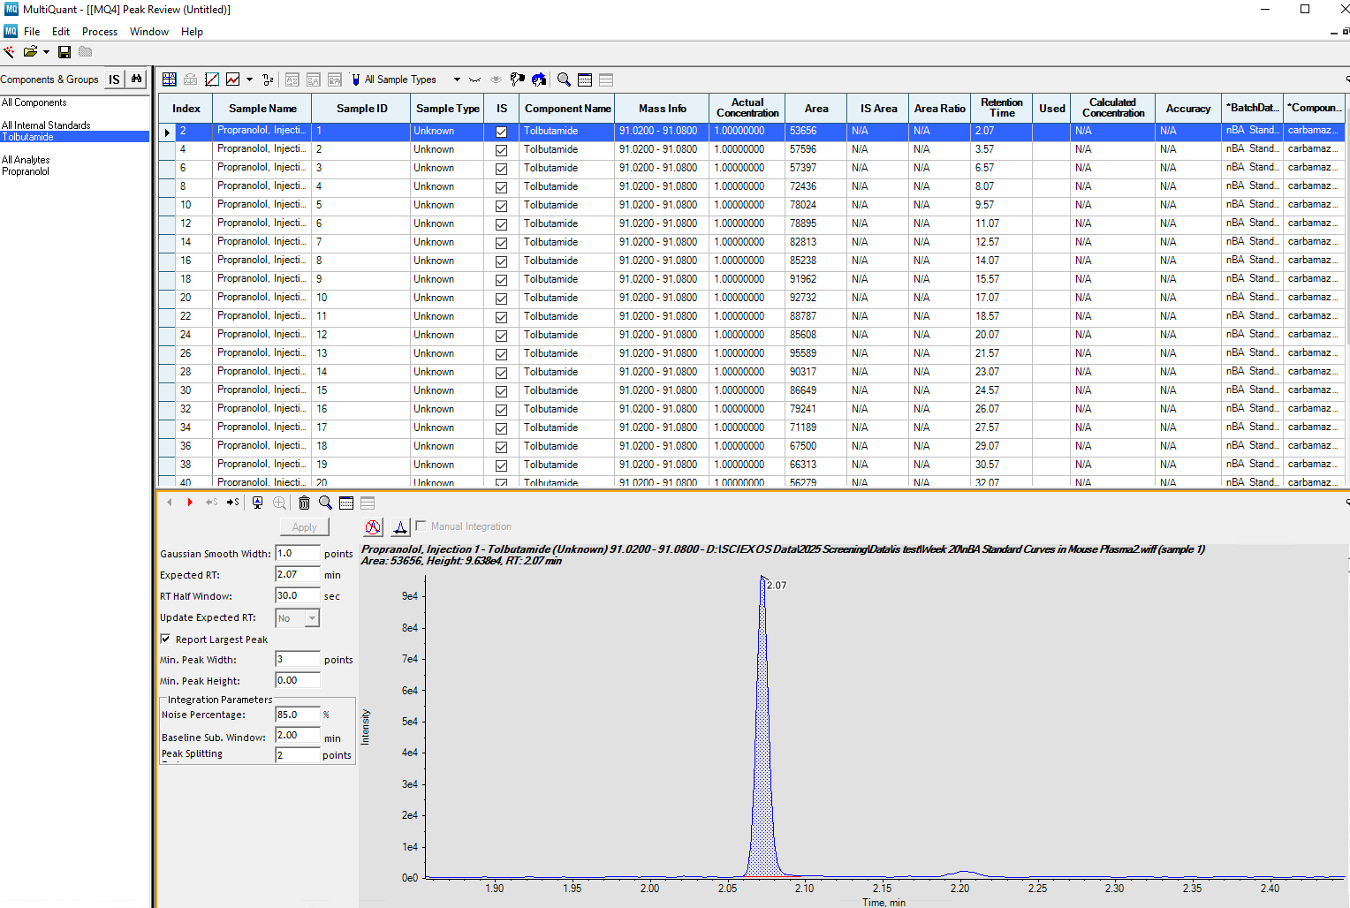
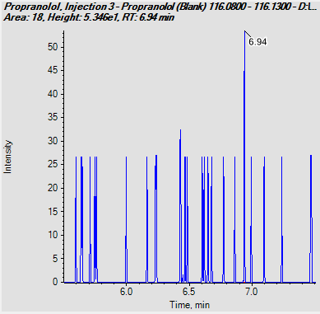
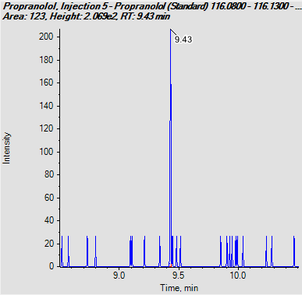
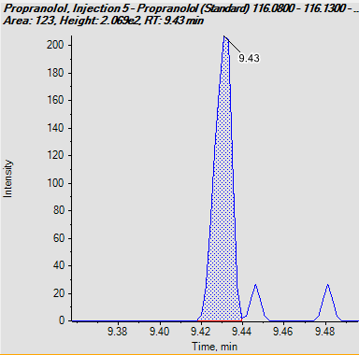
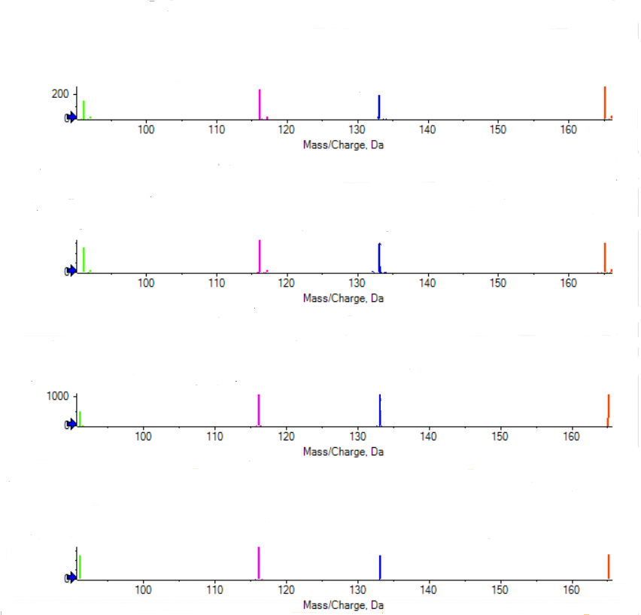
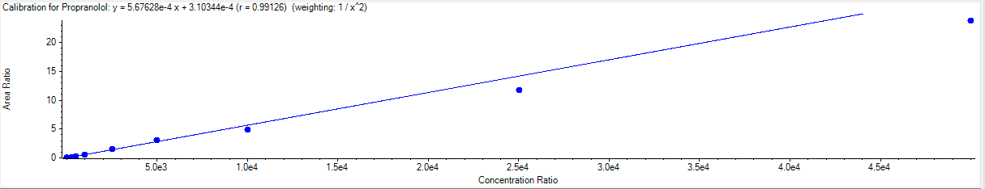
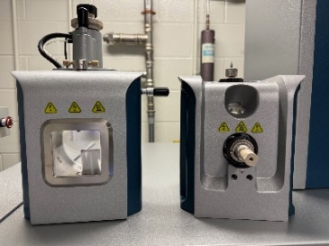
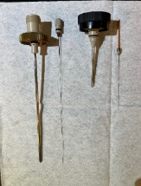
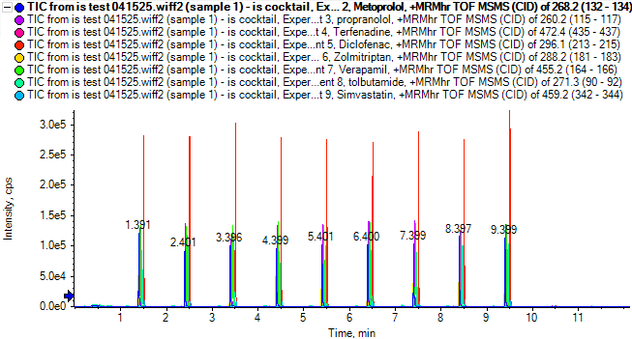
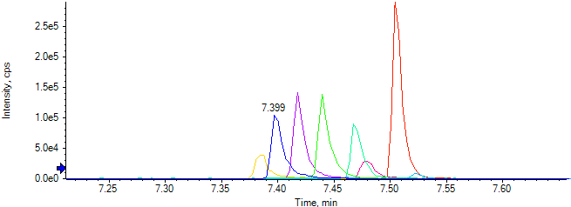
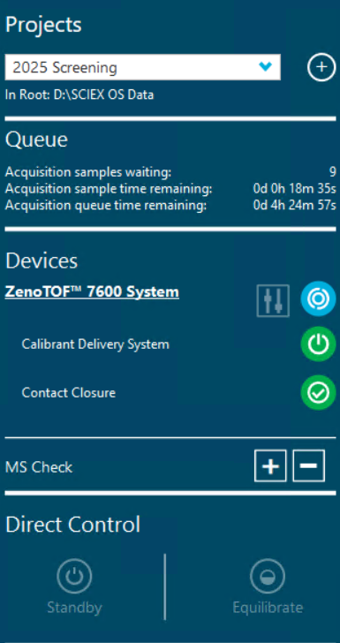
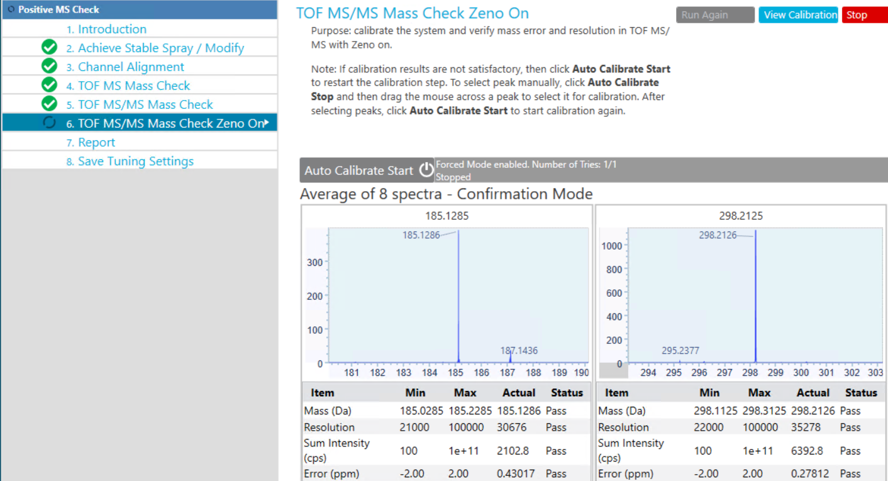
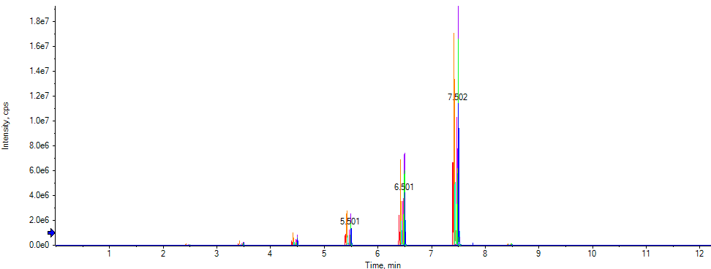
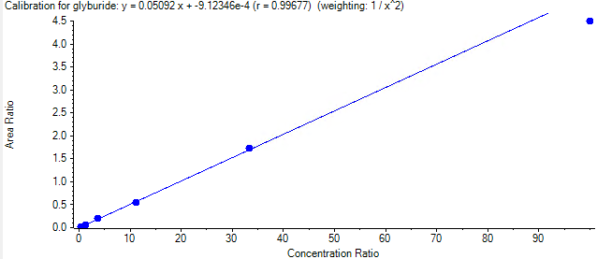
Integration of high-throughput, microflow LC-high-resolution mass spectrometry (HT-µfLC-HRMS) in early discovery bioanalysis
Brendon Kapinos¹, Jamie Tourville¹, Hannah Moulton¹, Matt Troutman¹, Steve Ainley², Wayne Lootsma²
¹Pfizer, Groton CT, ²Sound Analytics, Deep River CT
Abstract
Bioanalytical labs supporting early-stage drug discovery simultaneously optimize throughput, sensitivity, reproducibility and cost to drive sustainable portfolio impact. In addition, capacity for specialty, fit-for-purpose investigations can provide valuable metadata and clarity for enabling project progression. Mass spectrometry has become the tool of choice for biopharmaceutical discovery analysis, and nominal-mass instruments provide excellent sensitivity, robustness and throughput. High-resolution models have repeatedly demonstrated utility in providing highly-selective discrimination between analytes and facilitating high-fidelity untargeted analysis, however application to early-stage screening has been limited. Here we describe the integration of a state-of-the-art, high-resolution mass spectrometer (HRMS) for early-discovery bioanalysis. This work will highlight key features, capabilities and applicability of a novel high-throughput, microflow-LC-HRMS platform.
High-throughput, enterprise quantitative MS
HT-µfLC-HRMS for in vitro sample analysis
Control (100% inhibition)
A
B
A
B
C
D
Mtx 60 45 30 20 10 5 0 no-cof
Mtx 60 45 30 20 10 5 0 no-cof
Figure 3a-b. Early-discovery bioanalytical workflow supporting high-throughput in vitro screens. MS/MS method development delivers sensitive, selective MRM methods for new chemical entities (NCEs) . An enterprise database provides seamless sharing of MRM methods throughout the organization, analysis by triple-quadrupole MS is the current industry standard (A). Modern HRMS instruments can leverage existing databases to build high-resolution MRM methods (MRM-HR). With this scan mode, precursor ions are selected by a quadrupole at nominal mass and fragmented. Fragments are analyzed by high-resolution time-of-flight (TOFMS) for enhanced sensitivity and selectivity (B).
E
CV: 5%
F
[inhibitor]
Figure 6a-f. Optimized HT-µfLC-HRMS workflow and methods were piloted for analysis of plate-based discovery screens. Results from in vitro metabolic stability studies show good sensitivity and dynamic range, time-courses for diclofenac and propranolol shown (A+B). Data from high-throughput “cocktail” P450 drug-drug interaction (DDI) studies align with legacy (C). Multi-injected MRM-HR analysis of in vitro transporter studies indicated good internal standard reproducibility (D). Highly-selective mass extraction during data analysis (rosuvastatin probe substrate) delivers precise measurement and sufficient signal-to-noise throughout the 96-well study (E+F).
HT-µfLC-HRMS configuration
Zeno MRM-HR method, setup and workflow
A
B
A
B
Rosuvastatin
Q1 mass:482.2
TOF extraction range: 258.11-258.16
2
III
IV
3
1
II
C
HT-µfLC-HRMS for in vivo analyses
Table 2. in vivo sample preparation
Table 2. Feasibility for µfLC-HRMS support of early-stage in vivo studies was also assessed. Various small molecule standards were collected, and calibration curves were constructed at concentrations of 0.5-50,000ng/mL, in mouse plasma. Samples were processed using protein precipitation per volumes presented in the table.
Figure 7a-d. µfLC-MRM-HR analysis was performed on mock in vivo samples using methods presented in Figure 5D, followed by data processing and TOF fragment mass extraction in MultiQuant software. Matrix-matched blank (A) is devoid of analyte of interest (propranolol) with very low background observed. An LLOQ of 0.5ng/mL was achieved (B+C), with linear dynamic range of 0.5-50,000ng/mL (D).
I
Figure 4a-c. Configuring high-throughput, high-resolution MS analysis of known drug candidates by MRM-HR. An existing high-throughput MS workflow was leveraged with relatively minor adjustments for accessibility and transferability. An MRM-HR “starter method” was built within SCIEX OS software, containing source parameters and accumulation time (A). LeadScape software interfaced directly with an enterprise MRM database and controlled the LS-1 sample delivery system. Existing nominal-mass MRM methods were retrieved, and MRM-HR methods were built automatically. Bioanalysts can define TOFMS start/stop masses per analyte (B). Data analysis of multi-injected MRM-HR datasets was performed in SCIEX MultiQuant 3.03, TOF mass extraction ranges are user-defined per analyte (C).
Matrix | Sample volume | Precipitation volume | Supernatant volume | Diluent | Final sample composition
CD-1 Mouse Plasma | 10 µL | 100 µL | 50 µL | 150 µL (0.1% formic acid in water) | 25:75 acetonitrile: water (0.1% formic acid)
Table 1. System flow path
Figure 1a+b. A high-capacity microflow-HRMS system was assembled to readily integrate with an existing high-throughput MS fleet. An LS-1 sample delivery system-controlled with LeadScape software-and Agilent 1290 UHPLC pump were interfaced with a SCIEX 7600 ZenoTOF (A1-3). System layout was adjusted to place key components in close proximity, reducing delay, dispersion, and post-column volume for optimal microflow performance (B). Table 1 summarizes volume contributed by each flow path component.
Component | Dimensions (L x ID) | Volume (µL)
Sample loop (I) | 150mm x 100µ | 1.18
Transfer tubing (II) | 550mm x 75µ | 2.43
Column (III) | 30 x 0.5mm | ~3.75
ESI Electrode (IV) | 124mm x 50µ | 0.24
A
B
C
Platform performance and reproducibility
Figure 5a-e. With MRM-HR workflow feasibility established, overall platform performance, stability and reproducibility was assessed. Reproducible mass accuracy is crucial over months of screening operations; extracted TOF fragment masses collected during system suitability tests over 4 months show good alignment (A). Microflow LC (µfLC) performance was also optimized, and chromatograms from a multi-injected standard cocktail show reproducibility across response, chromatographic fidelity, and retention times (B+C). Linear dynamic range and sensitivity were evaluated against standard curves of small molecules prepared in 20:80 acetonitrile:water. Correlations were ≥0.99, and limits of quantitation well below 1nM were routinely observed. LC method details and calibration curve plot for glyburide is shown (D+E).
A
116.1057
133.0636
20-May
91.0531
165.0892
18-April
Metoprolol
Propranolol
Verapamil
Tolbutamide
D
HRMS system components and optimization
91.0537
116.1063
133.0640
165.0900
A
B
15-March
1
2
91.0535
116.1064
133.0640
165.0898
1
2
B
20-Feb
91.0538
116.1065
133.0642
165.0902
Conclusions
C
Metoprolol
Propranolol
Terfenadine
Diclofenac
Zolmitriptan
Verapamil
Tolbutamide
Simvastatin
A high-throughput, microflow LC-HRMS platform was positioned for early drug discovery bioanalysis. System design and parameters were optimized for throughput, ruggedness and ease-of-use, streamlining integration alongside nominal-mass instruments.
Existing enterprise LCMS methods database was leveraged for high-resolution MRM (MRM-HR) method-building, providing enhanced sensitivity, selectivity, and overall similar workflow to nominal-mass analysis.
Good reproducibility was observed across various metrics, including mass accuracy, chromatographic performance and response.
Sensitivity and selectivity provided high-quality data across in vitro and in vivo analyses, and quantitative performance was suitable for a broad range of discovery and screening study types.
C
D
D
Glyburide
Atorvastatin
Tolbutamide
Timolol
Diphenhydramine
Valsartan
Bosentan
Amitriptyline
Diclofenac
E
Figure 2a-d. ZenoTOF system features facilitating high performance and ease-of-use are highlighted. Standard TurboV source provides a single probe for LC and calibrant inlets (A1). Optional OptiFlow source optimizes electrode length and post-column volume at micro-flow rates, and relocates calibrant inlet to front of the source (A2, B2). MS calibrant delivery and routine are fully- integrated and automated (C+D).
Mobile phase A: 0.1% formic acid in water
Mobile phase B: 0.1% formic acid in acetonitrile
1µL injection volume
Phenomenex Kinetex C18 2.6µ 30x0.5mm
Linear gradient from 0.05-0.6min
60s cycle time
Acknowledgements
0.41nM 1.23nM 3.7nM 11.1nM 33.3nM 100nM
The authors would like to thank Chris Healy (Pfizer) for insights on microflow LC system optimization, as well as Tom Abbott, Chang Liu, and Joe Doktorski (SCIEX) for their assistance configuring ZenoTOF methods and settings.
All procedures performed on animals were in accordance with regulations and established guidelines and were reviewed and approved by an Institutional Animal Care and Use Committee or through an ethical review process.

