Slide 1

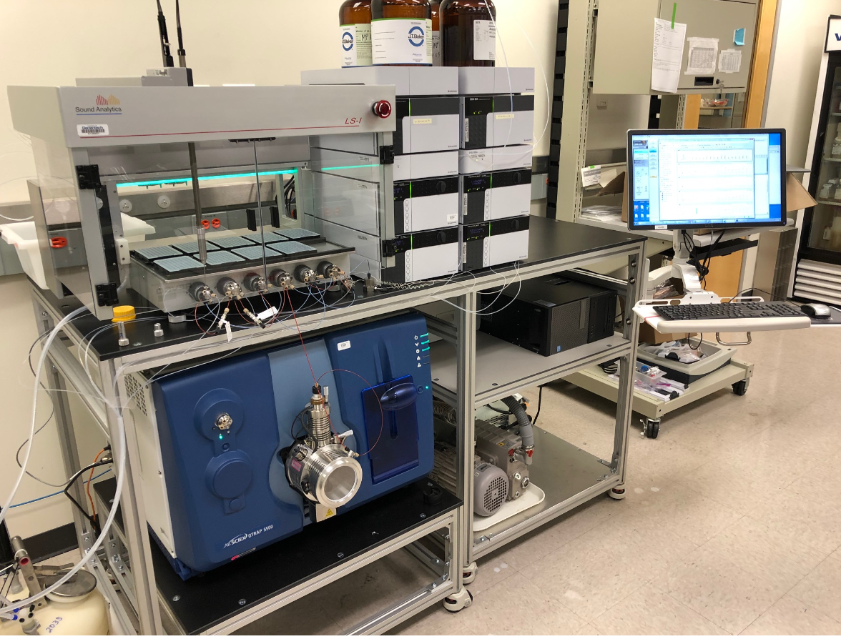



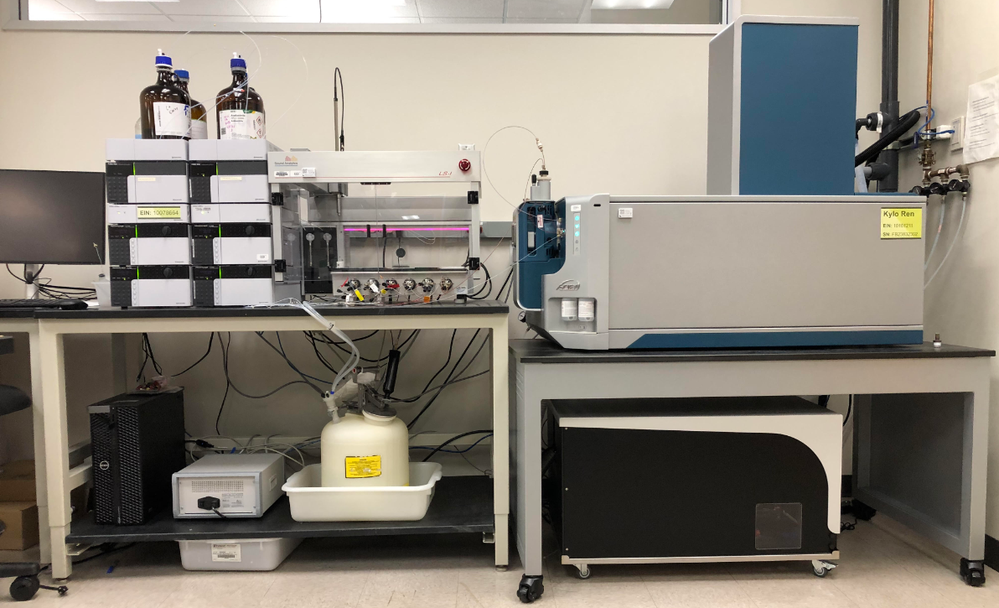
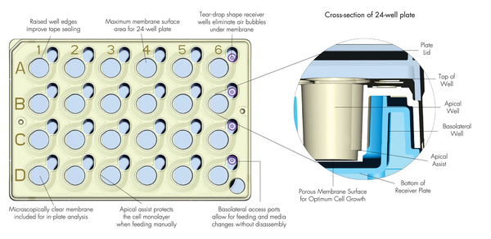
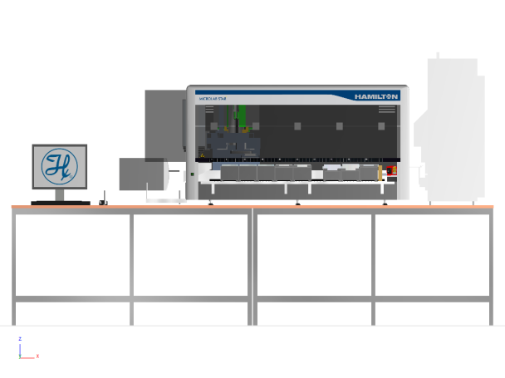
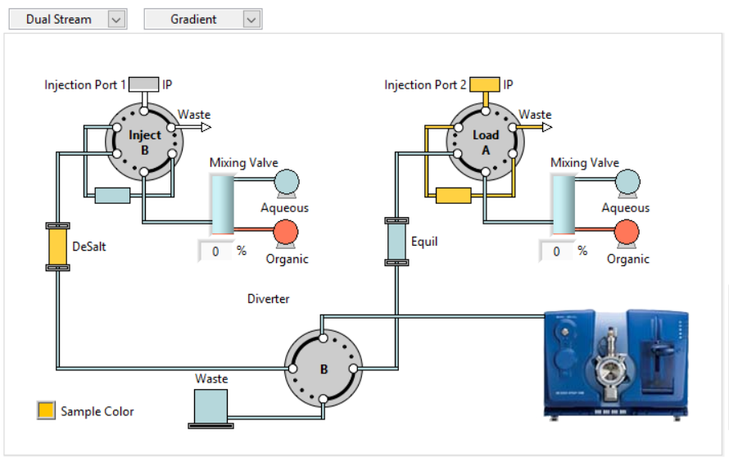
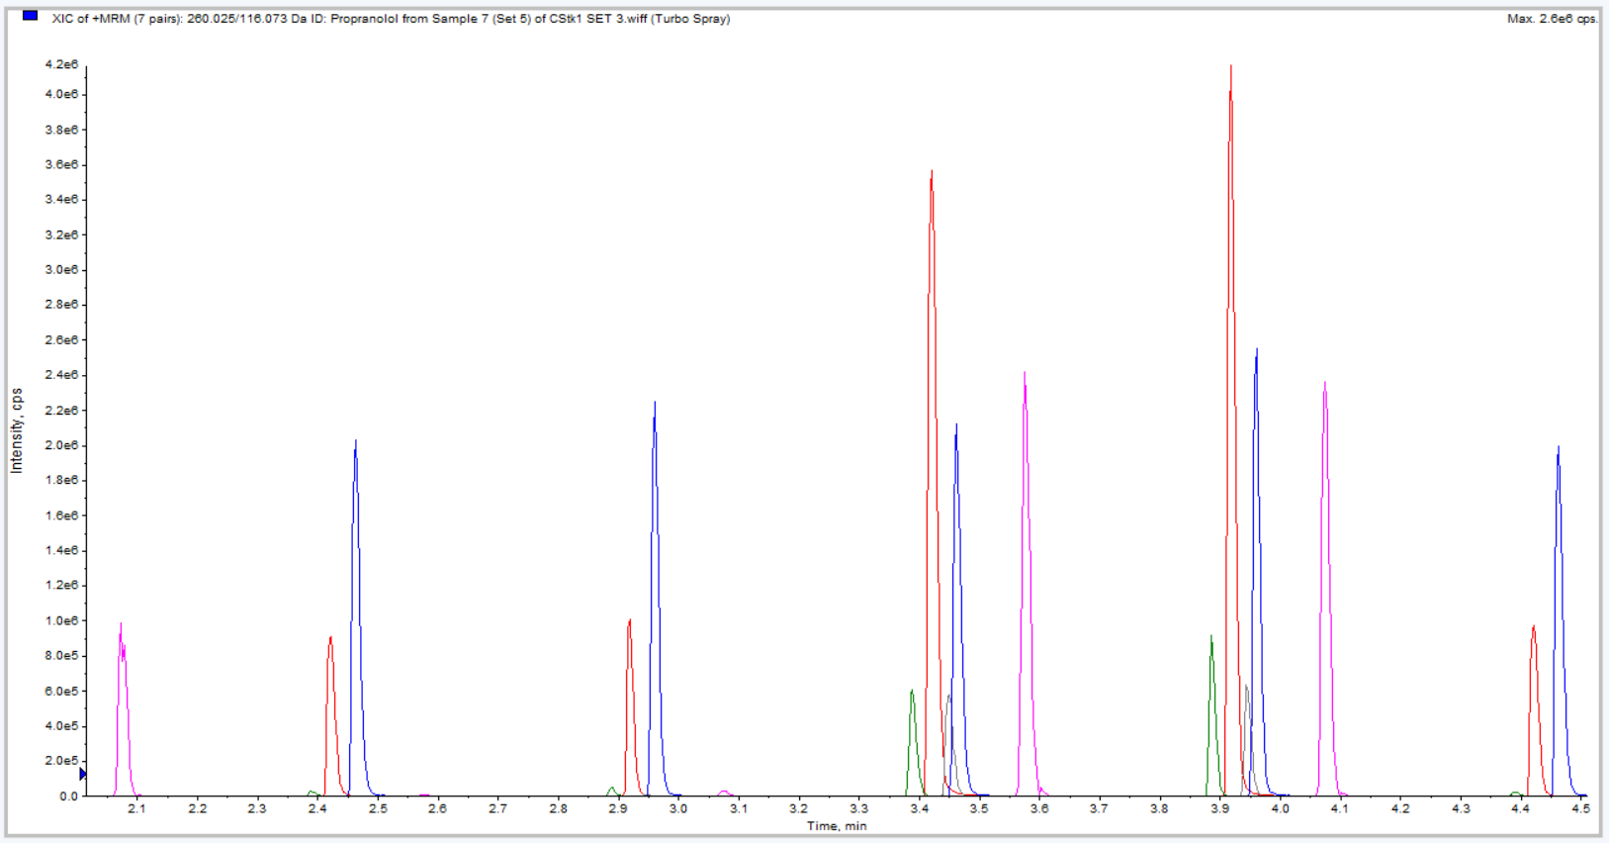
Implementation Study: Quantitative Tuneless High Resolution LC/MS workflows for improved assay productivity and success for ADME permeability studies.
Emile Plise¹, Christopher Chhin¹, Jamie Jorski¹, Liuxi Chen¹, Loren Olson², Jeremy Lawton², Steve Ainley³, Wayne Lootsma³, Laurent Salphati¹
¹Genentech Inc., South San Francisco, CA, ²Sciex, Concord, ON, Canada ³Sound Analytics, Deep River, CT
POSTER MP097
Introduction
Permeability Assay Methods
QTRAP4500 DiscoveryQuant/LeadScape Automation Workflow
Traditionally in ADME/PK environments discovery NCE’s are submitted to several in vitro ADME assays to predict drug-ability and choose leads for subsequent in vivo studies. LC/MS/MS is commonly used to quantitatively measure these NCE’s which necessitates method development for selected reaction monitoring (SRM/MRM) on large numbers of compounds. Over time, improvements in automation and algorithm design have increased the productivity and success rate of ADME assays, but new modalities and increasing performance demands continue to present challenges. In particular, difficult to fragment, large “small molecules”, and cyclic moieties are challenging classes that tend to have poor success rate in automated MRM tune approaches. Here we study the feasibility of using HRMS for quantitation of ADME permeability samples.
This fully-automated permeability/transporter assay is run on a Hamilton StarPlus with plate reader and incubator. Permeability or transport is assessed in gMDCK cells (endogenous canine Mdr1 KO) or gMDCK cells transfected with the human MDR1 gene (gMDCK-MDR1) seeded on Millipore 24-well plates (PET, 1 µm pore) at 5.2 x 10⁴ cells/well and cultured for 4 days. The compounds were tested in duplicate in the apical to basolateral (A to B) and basolateral to apical (B to A) directions at 10µM (gMDCK) or 5µM (gMDCK-MDR1) with 1% DMSO and lucifer yellow in all donor chambers. The receiver chambers were sampled at 1, 2, and 3 hours. Samples were run on the QTRAP4500 then the same samples were transferred to the ZenoTOF 7600 for analysis the next day.
1. DMSO stock solutions from compound management
5. Upload new MRM LC/MS/MS conditions are stored in ‘Global‘ DiscoveryQuant Microsoft SQL Server® database.
2. Dilute into 96-well plates
6. LeadScape accesses stored MRMs to build acquisition methods at time of sample submission
3. Inject using DiscoveryQuant
Quick and fine tune
Chromatune (on column LC check)
Workflow Summary (Based on 96 compounds/per run)
Steps 1 and 2 take about 30 mins.
Step 3: ~ 2.5 mins/sample for quick and Chromatune (~ 4 - 5h).
Tune fails occur approximately at a rate of ~3%-5%
A manual verification/retune takes ~30 mins per compound
Total instrument and hands on time for tuning: ~6 - 7 hr
LS-I/LeadScape WorkStation
4500 Qtrap plumbed for ‘Duality’ dual-stream LC/MS/MS. Dual Binary Gradient Nexera pumps (Shimadzu)
4. Failed tunes
Manual Q1 verification and re-tune
Methods
ZenoTOF 7600 Tuneless Workflow
The sample delivery system consisted of an LS-I autosampler with 10-plate capacity, 8-two position UHPLC valves (including up to 4 injection ports).
The valves are arranged under the plate deck and across the front of the instrument. The system was configured with two Shimadzu Nexera binary gradient pumps and Sciex QTRAP 4500 or a Sciex ZenoTOF 7600 mass spectrometer.
The systems were controlled by LeadScape software (SoundAnalytics). LeadScape handled batch creation, valve scheduling, gradient LC control and MS signal acquisition.
MRM data acquired on the 4500 was viewed using LeadScape software. HR data from the 7600 was reviewed using MulltiQuant 3.0.
Workflow Summary (Based on 96 compounds)
Steps 1 – 6 from the DiscoveryQuant workflow are not needed
Failure rate is < 1 %
  Fails may be due to ionization or compounds not compatible with the 30 sec LC gradient
  Data is acquired using high resolution and SWATH (salvage route 1)
  Salvage route 2: ~ 30 mins to manually re-tune and run on a QTRAP 6500 with a standard LC, 50 x 2.1 mm column), ~ 2 - 2.5 min run time/sample
Total instrument and hands on time saved without tuning: ~ 6 – 7 hr
Apical side “A”
Basolateral side “B”
The Hamilton StarPlus generates 1728 samples for 96 compounds
Using a traditional HPLC and autosampler with a 2 min LC, run time = 58 hours
Implementing the LS-1 autosampler (30 seconds/sample) = 15 hour run time
Data processing times for both the DiscoveryQuant and 7600 workflow are similar
LS-I/LeadScape WorkStation
7600TOF plumbed for ‘Duality’ dual-stream LC/MS/MS Dual Binary Gradient Nexera pumps (Shimadzu)
Hamilton StarPlus
Figure 1
Dual-Stream LC plumbing as depicted in LeadScape software.
gMDCK A to B Papp Values for Select Low, Moderate and Highly Permeable Drugs
Efflux Ratios for Drugs in gMDCK-MDR1 Cells
Conclusions
The QTRAP4500 DiscoveryQuant/LeadScape Automation Workflow was implemented about 7 years ago and dramatically reduced LC/MS run time versus a standard HPLC and autosampler configuration
For the first time a ZenoTOF 7600 has been integrated with a LS-1 autosampler
The new ZenoTOF 7600 tuneless workflow has been successfully applied to in vitro permeability and efflux transporter studies
The tuneless workflow has decreased hands-on preparation time and tune failures
The tuneless workflow is robust and results are similar to or better than those obtained using our QTRAP4500 DiscoveryQuant/LeadScape
Since implementation 6 months ago, >1200 compounds have been tested using the tuneless workflow
Figure 2
Dual-Stream LC/MS, 1 min cycle time per channel.
CH1/ CH2 Injections are offset by 30 sec.
Flowrate was 0.85 mL/min. Halo 2X20mm, C18, 2.7µm.
30 second acquisition per sample
Cimetidine (low permeability) was detected by the 7600 but BLOD on the 4500Qtrap
The remainder of the compounds exhibited similar Papp values when analyzed on both the Zeno7600TOF and QTRAP4500 systems
ZenoTOF7600: Data was obtained for 6/6 compounds tested
QTRAP4500: Data was obtained for 5/6 compounds
The peaks for afatinib and paliperidone (MDR1 substrates) were BLOD in the A to B direction, therefore efflux ratios could not be determined
The remainder of the compounds exhibited similar efflux ratios when analyzed on both the Zeno7600TOF and QTRAP4500 systems
ZenoTOF7600: Data was obtained for 5/5 compounds tested
QTRAP4500: Data was obtained for 3/5 compounds
The authors declare no competing financial interest..

